Slide 1
IoT - It's Not Just a Buzzword
Notes:
IoT = Internet of things
How many of you are human?

Slide 2
How many of you have an automated home?
Notes:
Do you know what your top consumers of electricity are?
Do you know if replacing your refrigerator would pay for itself?

Slide 3
How many of you collect data from your car?
Notes:
Do you know when something is going to fail in your car?
Does your mechanic?

Slide 4
Do manufacturers know how to collect and use the data they generate?

Slide 5
Why not?
Notes:
I hear people tell me that IoT isn’t anything new.
So why not?

Slide 6

Notes:
Because it’s a pain in the ass
Things don’t work together, and everyone is cookie licking

Slide 7

Jason Young
Senior Program Manager
Notes:
I help large ISV’s (independent software vendors) build or move applications to Microsoft Azure.

Slide 8
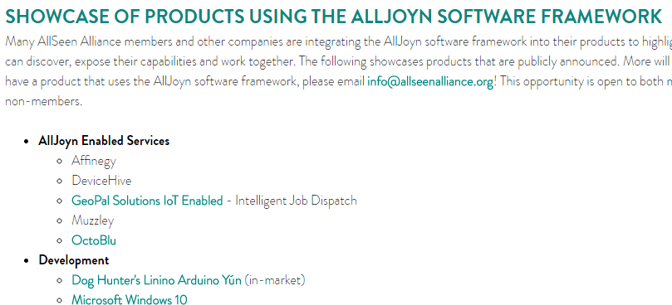

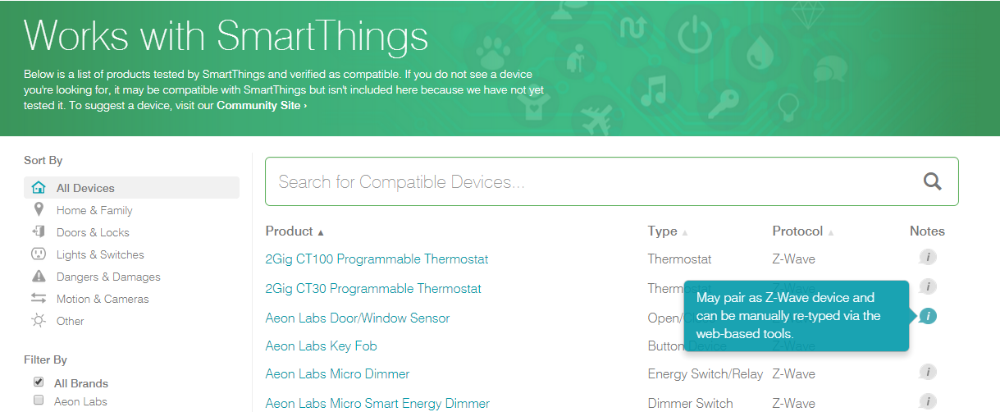



Notes:
IoT. What a mess.
Gartner says that within 6 years, there will be 26 billion “things” online. It won’t take long before there are more IoT devices than computers.
Gartner has the most conservative estimate.
We need to figure this out.

Slide 9
IoT is just a…
Buzzword…
A Fad…

Slide 10
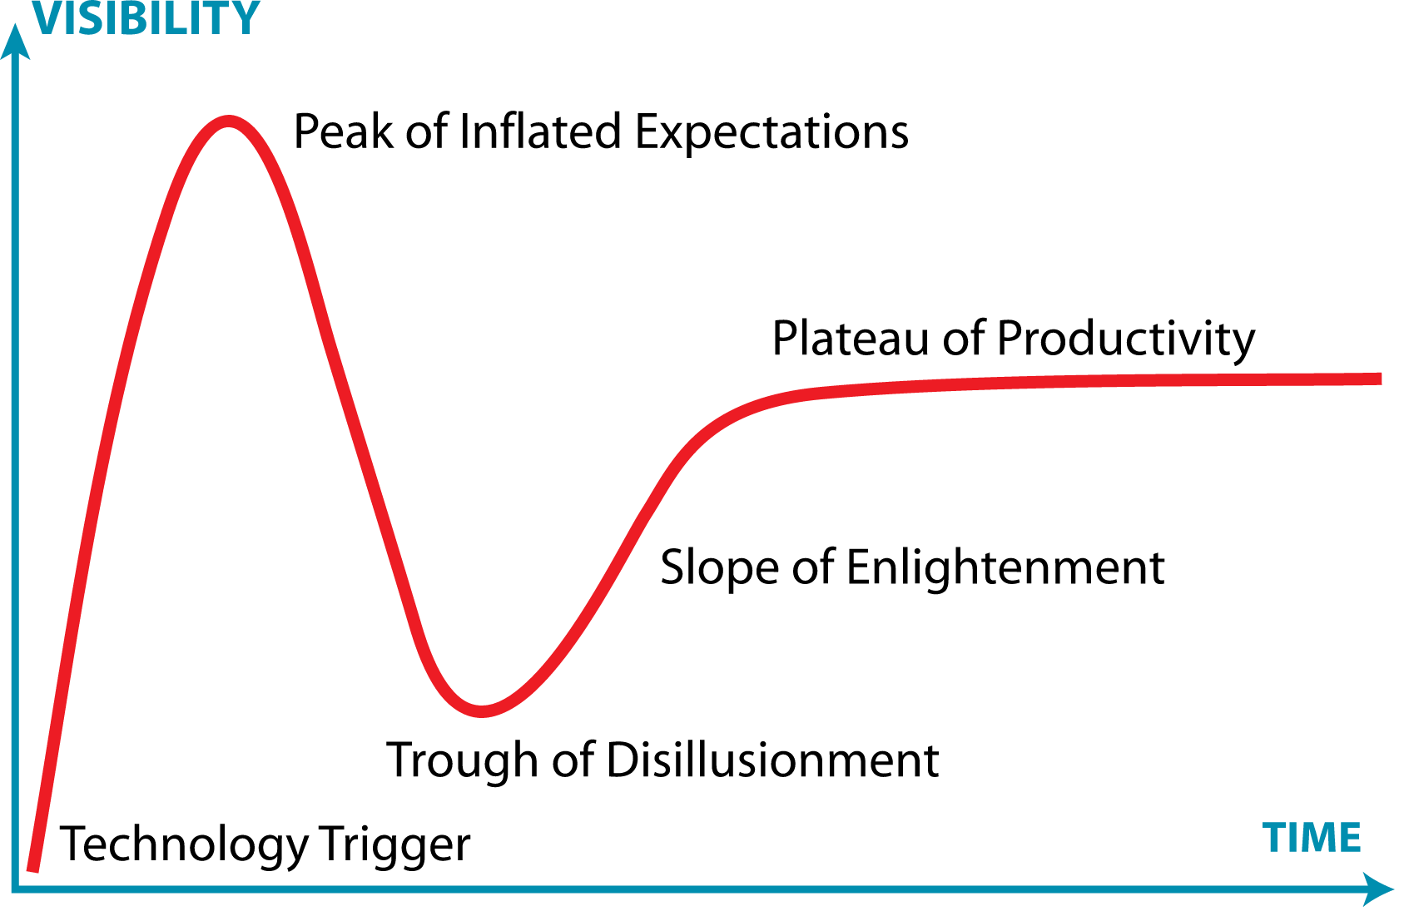
You are here
Notes:
Gartner hype curve
Yes, “IoT” is a buzzword.
No, that doesn’t make it meaningless.
Yes, it will be important. VERY important.

Slide 11
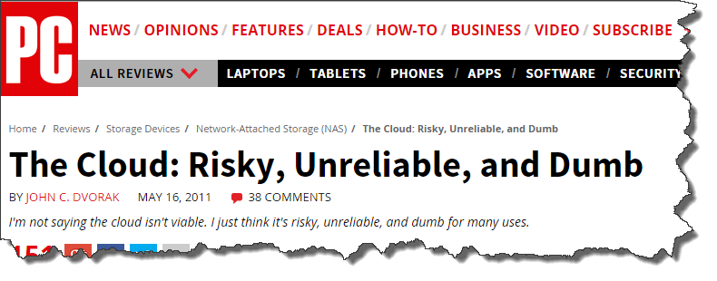
“People fear what they don't understand”
-Andrew Smith
Notes:
“The Cloud” is another phrase that has changed over time, and today it means something very important.
IoT is starting to mean something. Something important.

Slide 12
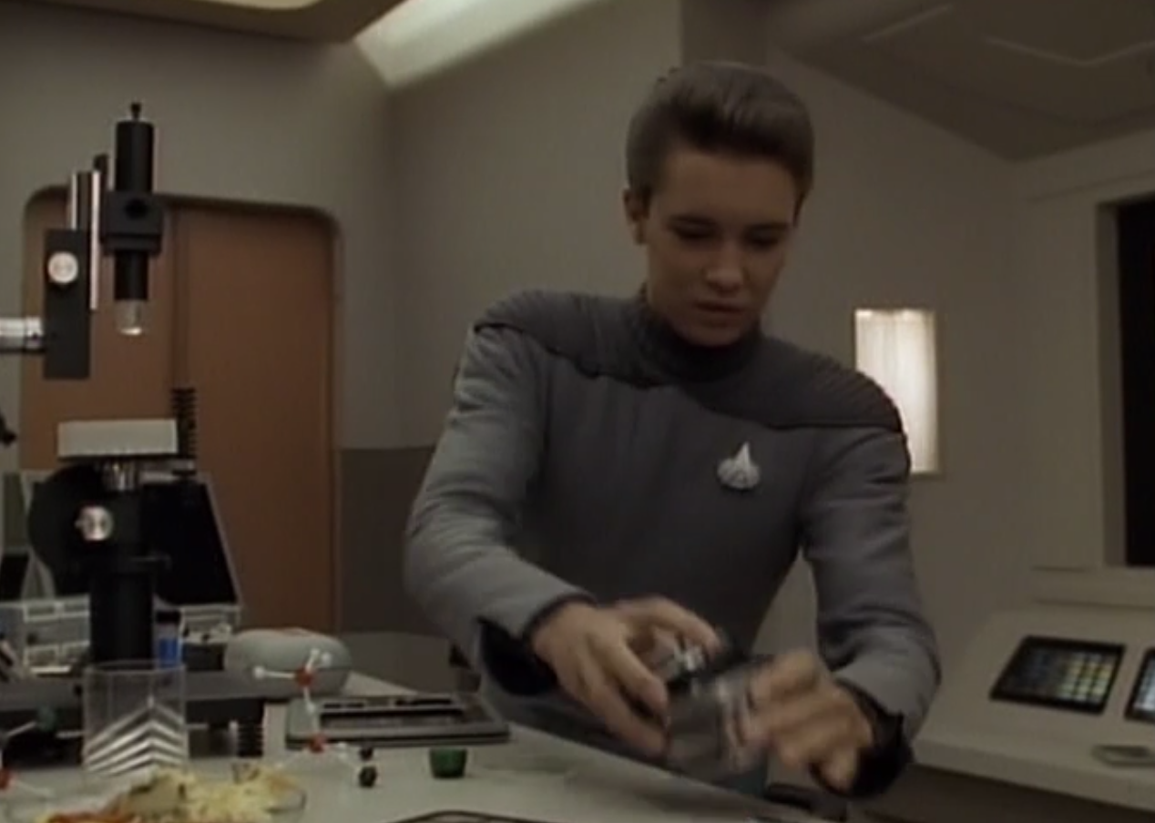
Notes:
ST:TNG S3, Evolution
Wesley Crusher was just called up to the bridge, so he’s putting his nanites away.

Slide 13
What is the Internet of Things?
Things
Connectivity
Data
Analytics
Notes:
Physical “things” such as devices and sensors. This is the easy part. Costs are going down.
New and improved!
Those “things” that have connectivity to either the internet or to each other or humans
These things have the ability to collect and communicate information
Analytics gives us information to make decisions

Slide 14















Microsoft Azure IoT services
Producers
Producers | Connect Devices | Storage | Analytics | Take Action
 | Event Hubs | SQL Database | Machine Learning | Azure Websites
 | Service Bus | Table/Blob Storage | Stream Analytics | Power BI
 | External Data Sources | DocumentDB | HDInsight | Notification Hubs
 |  | External Data Sources | Data Factory | Mobile Services
 |  |  |  | BizTalk Services
{ }
Notes:
Azure has a lot of services that align well with IoT scenarios
As we think about Azure IoT services, there are a collection of capabilities involved.
First there are Producers. These can be basic sensors, small form factor devices, traditional computer systems, or even complex assets made up of a number of data sources.
Next we have the Connect Devices capabilities on the ingress level within and around Azure. The primary destination is Service Bus & Event Hubs, but this relies on client agent technology either at the edge device level or within a field or cloud gateway. We also have capabilities for other external data sources to provide data
As data is ingressed to Azure, there are various Storage options there can be a number of destinations engaged. Traditional database technology, table or blob, or even more complex destinations like Document DB are possible. External or third party technologies can also be used. This is where the flexibility and agility of a platform shows its strength, This is where analysts like Gartner are forming opinions about just how robust our platform can be.
As this data is processed in Azure, there are a number of capabilities that can be utilized. Machine Learning, HD Insight, Stream Analytics are examples of tools that can analytics the data in various ways.
Finally the concept of Take Actions uses Azure services. Data may populate a LOB portal, be pushed to apps, or presented in analytics and productivity tools. These are all ways that the data gets out of these architecture points to allow organizations to use analysis to change / transform their business.
Through all of these areas, there is the possibility of utilizing existing investments either within your Azure environment, or elsewhere.

Slide 15


Azure IoT Suite
IoT Applications … to build a Proof of Concept… that scale to full production … on any asset
Remote
Monitoring
Asset
Management
Predictive Maintenance
…future applications
Notes:
At convergence we announced the Azure IoT suite. This is a set of services specifically designed to help you manage IoT scenarios.
Our initial applications will include:
Remote monitoring:
Obtain insights on asset utilization and get alerts of conditions important to your business
Asset management:
Manage and control your assets through a centralized management portal.
Predictive maintenance:
Leverage data collected from your assets to train and publish predictive models to avoid costly down-time
And we will have many future applications over time.

Slide 16

Notes:
Wesley has just realized some of the nanites have gone missing

Slide 17
Things

Slide 18
Samsung CEO BK Yoon promised that by 2017, 90% of Samsung devices will be IoT devices
http://www.eetimes.com/document.asp?doc_id=1325181
Notes:
Their goal is within 5 years to be at 100%.
Samsung makes 20 devices per second. This is big news.
IoT cost approaches zero.
Ok, maybe IoT is important.

Slide 19
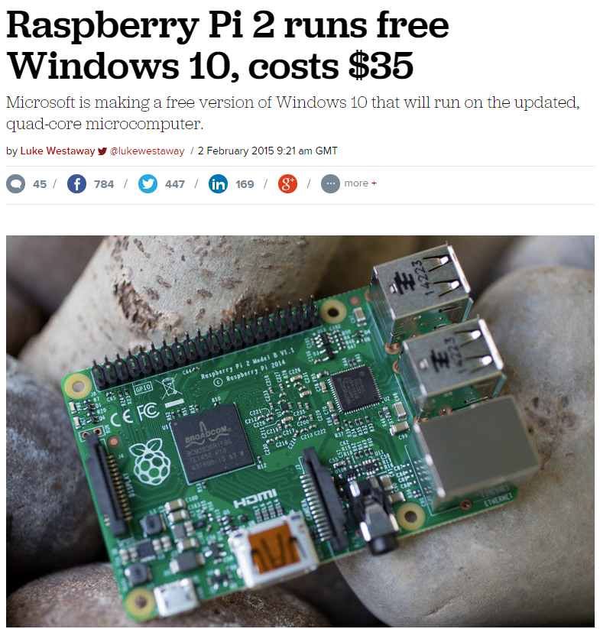
Notes:
Why use Windows?
Run universal apps
Share your codebase

Slide 20
Connectivity
Notes:
The cost of connectivity has been going down, and reliability has been going up.
Everything will be connected
The cloud provides a central, scalable location to push data

Slide 21

Notes:
We’re supporting AllJoyn in Windows 10.
AllJoyn is a protocol that enables devices to interoperate.

Slide 22
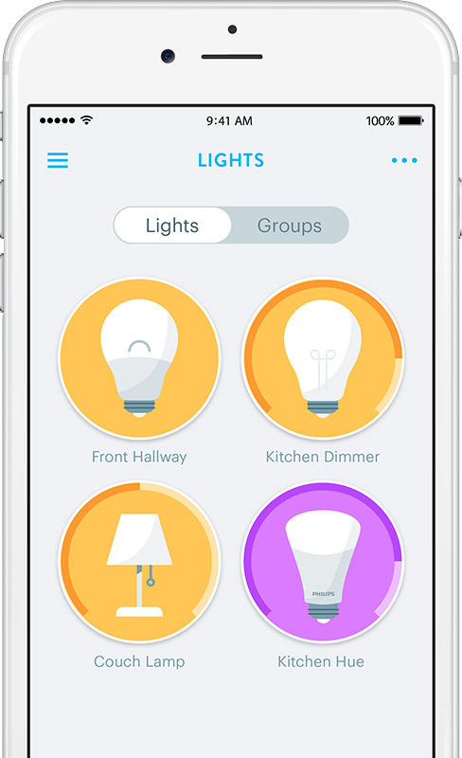
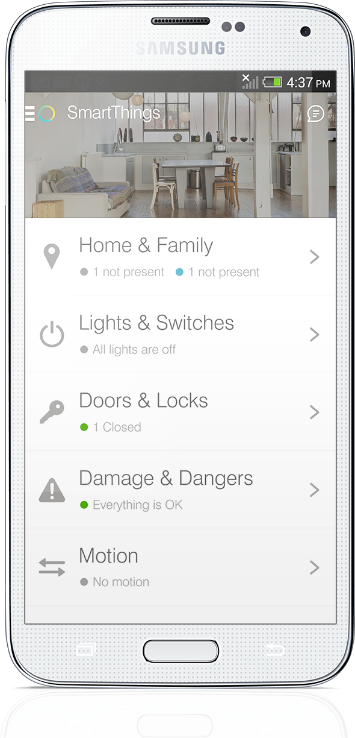


Notes:
There are products that abstract the protocols away, and focus on activities
Most importantly, they focus on the user

Slide 23
Event Hubs
1 million secure publishers
1 million events / second
Durable buffer
Multiple Consumers
Inexpensive
This per Event Hub!
Notes:
Each publisher has a SAS token that defines the policy and expiration
This is PER event hub

Slide 24
Event Hubs Demo
Device
Event Hubs
Stream Analytics
PowerBI

Slide 25
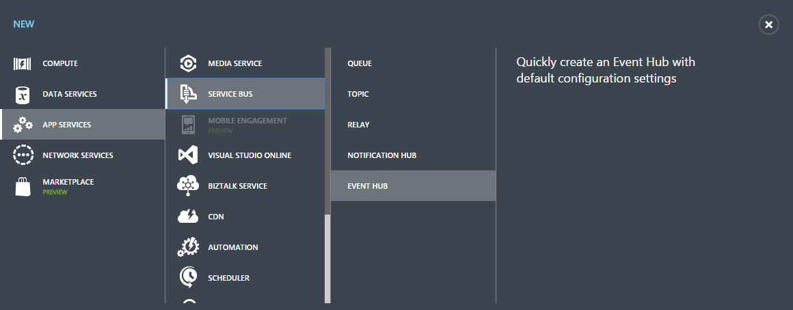

Slide 26
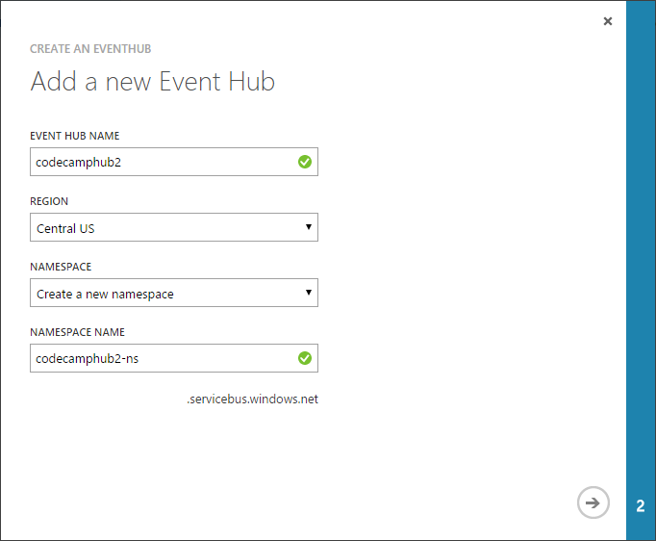
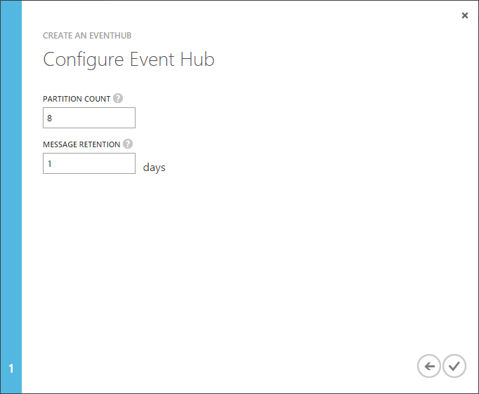

Slide 27
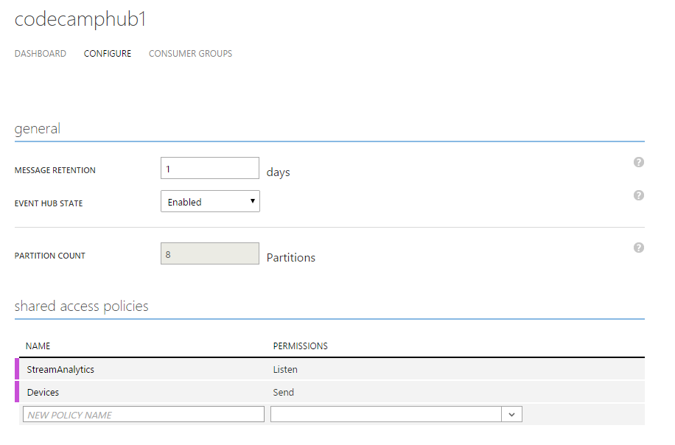

Slide 28
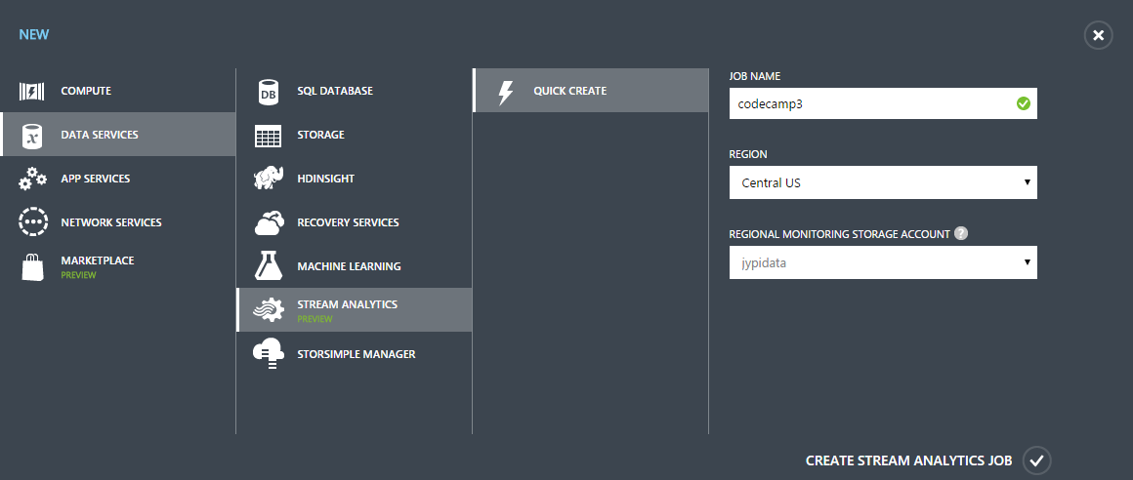

Slide 29
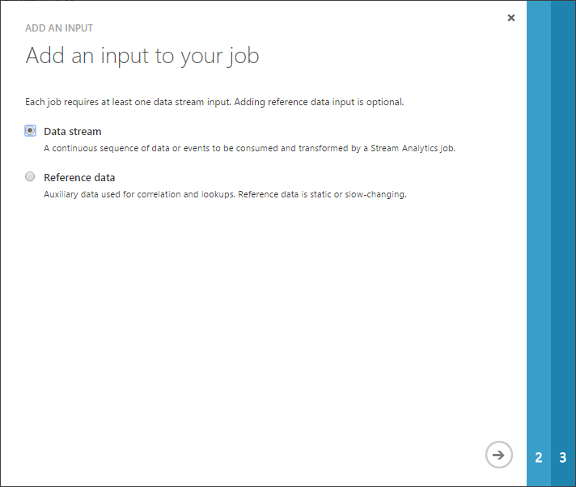
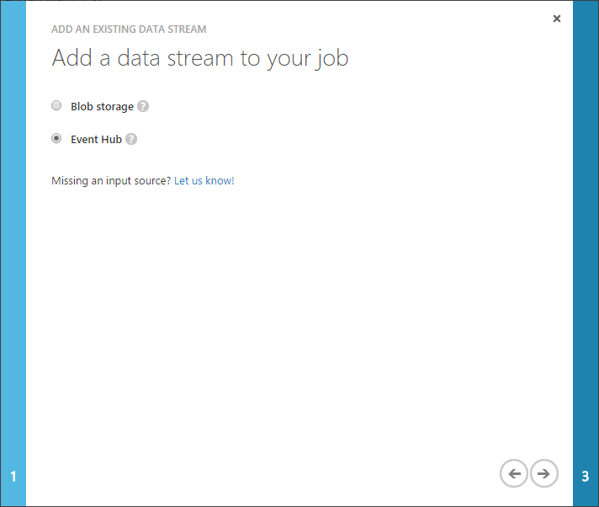

Slide 30
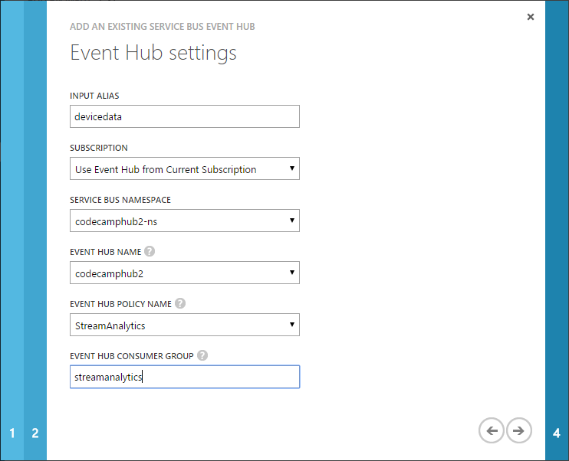
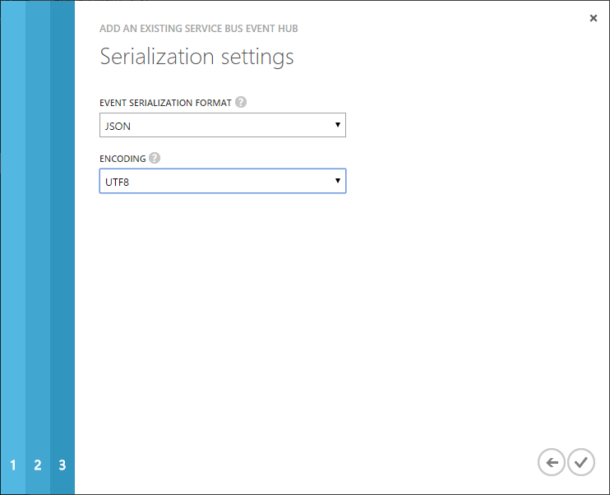

Slide 31
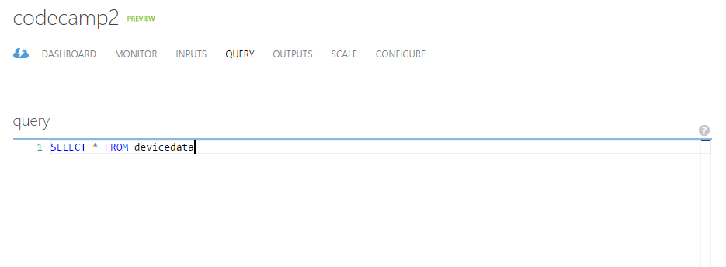

Slide 32
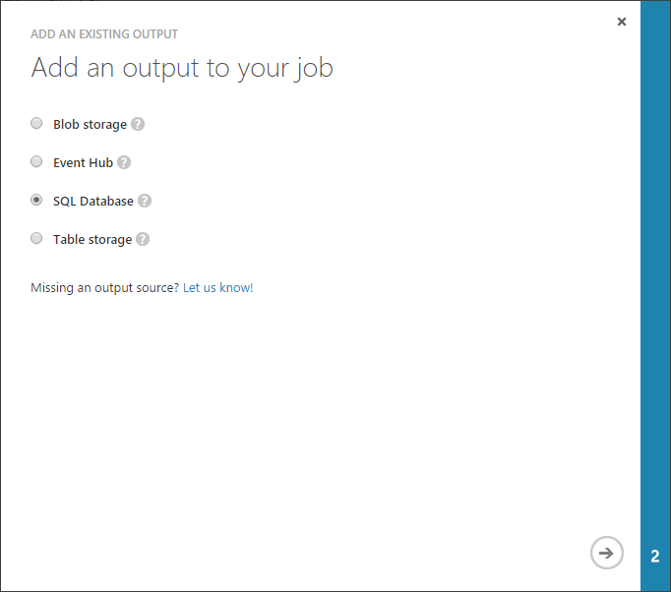

Slide 33
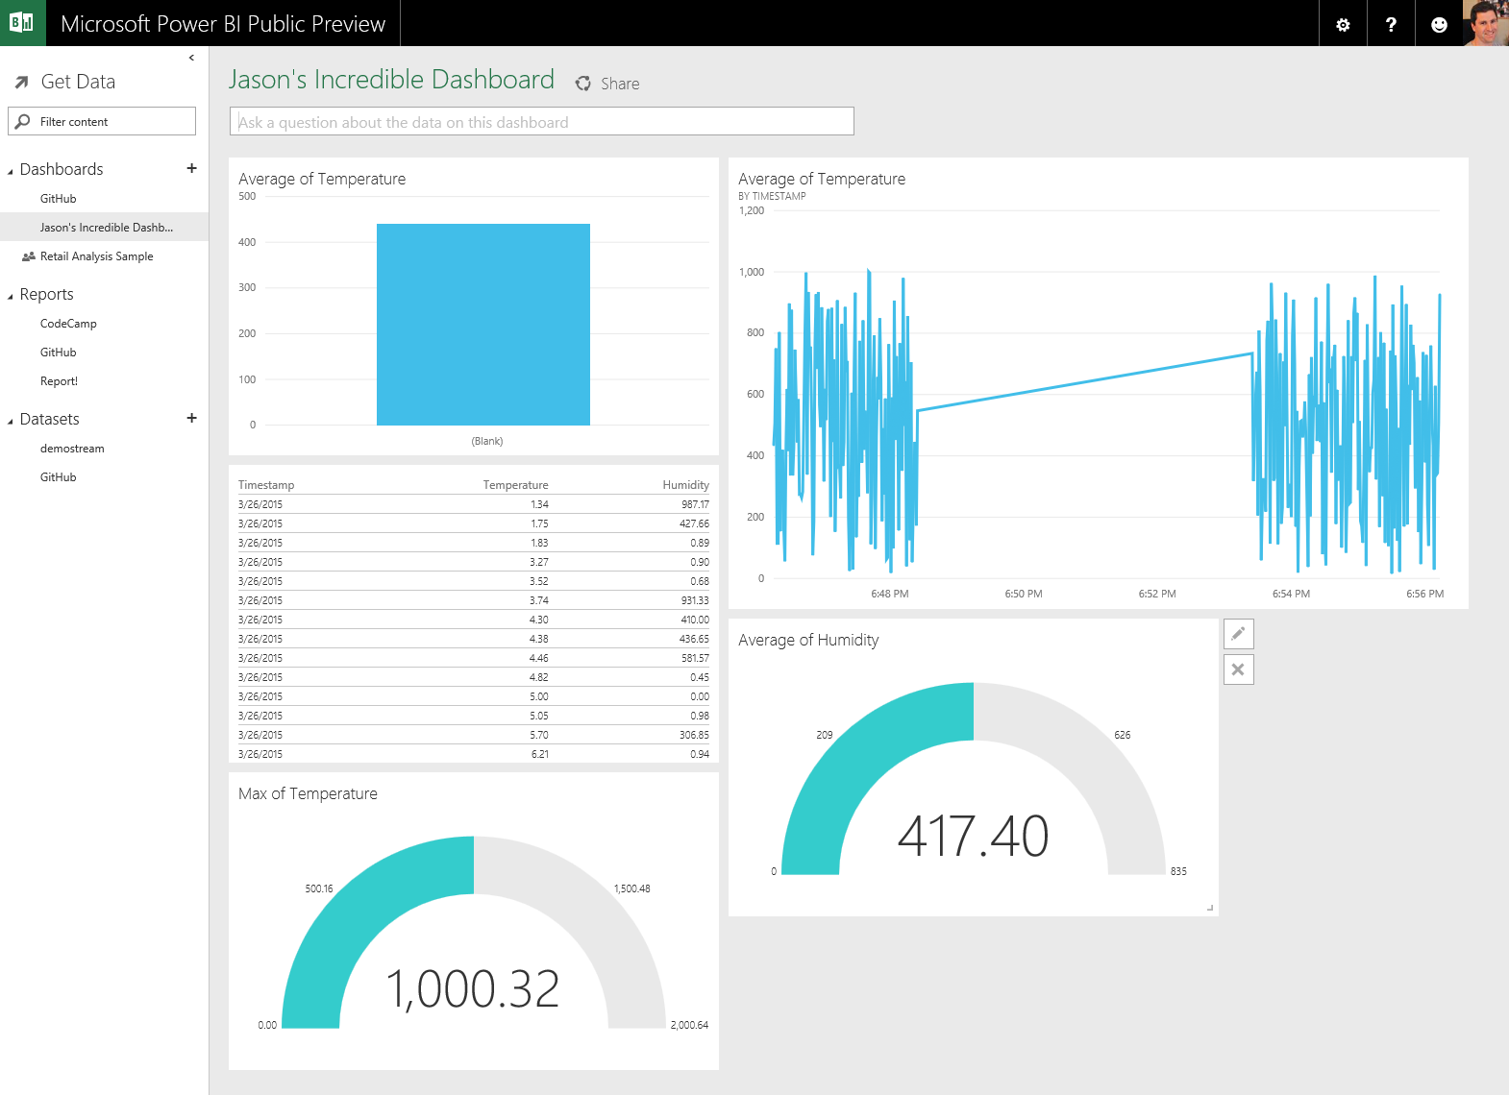
Notes:
Issues that are open sorted by date
Issues that were closed by stephentoub
Average time to close in hours

Slide 34
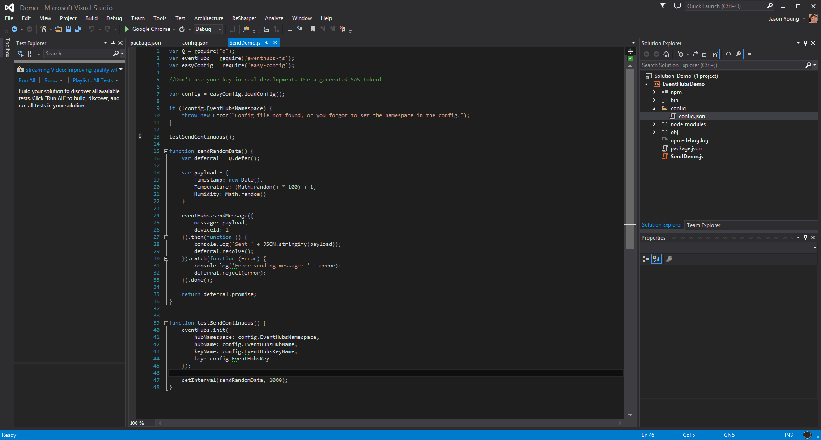

Slide 35

Notes:
This doesn’t look good. Wesley is still looking for the nanites.

Slide 36
Data
Notes:
The cloud provides a scalable, reliable place to store data

Slide 37
Storage
SQL Database
Blob Storage
Document DB
Notes:
Create SQL database
Create analytics stream
Connect to the database
DocumentDB is a cloud-native JSON document store

Slide 38
Analytics
Notes:
The cloud provides a scalable solution for doing big data analytics and on-demand queries

Slide 39
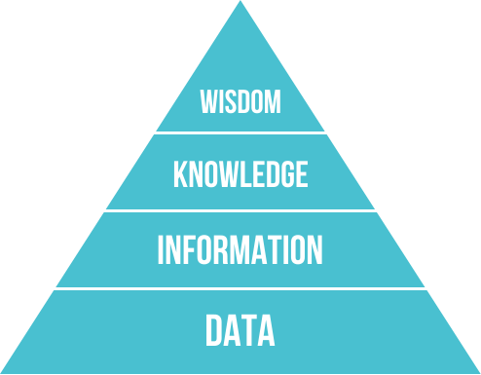
Notes:
Analytics is the process of taking all of the data that used to go unused, and turn it into information, knowledge, and wisdom.

Slide 40
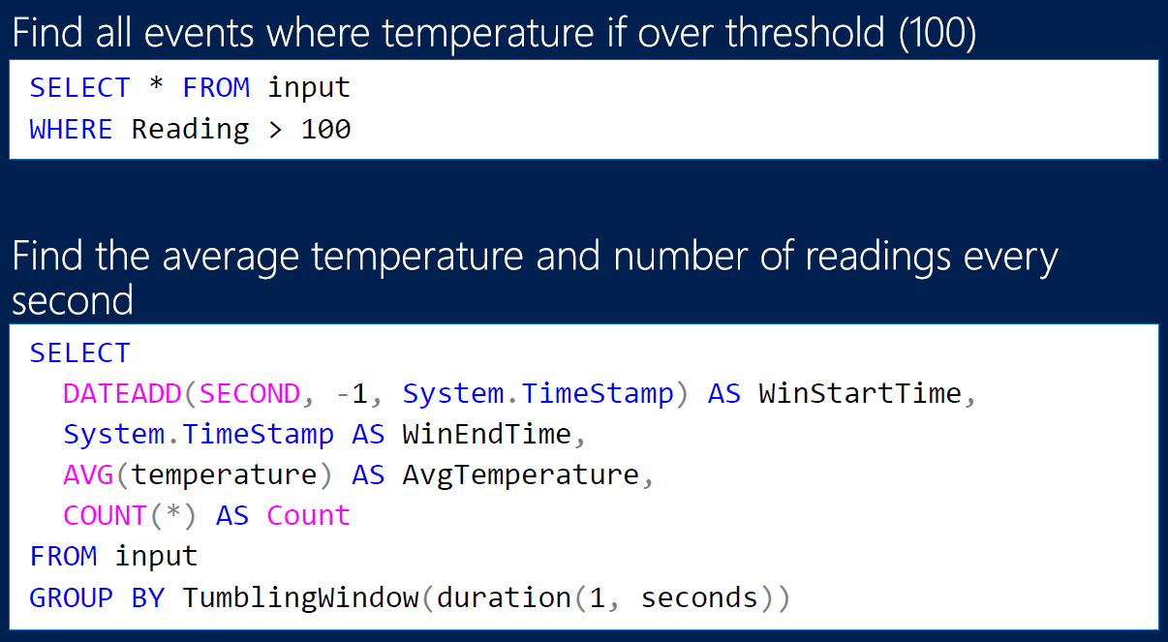
Stream Analytics
Select * from Source
Notes:
Output to another event hub, blob storage, or SQL database

Slide 41
Machine Learning
Preventative maintenance is largely ineffective
Age is not a good indicator of failure
http://www.arcweb.com/Blog/Post/260/Proactive-Asset-Management-with-IIoT-and-Analytics
Notes:
One of the key use cases is predictive maintenance
Read this: http://www.citeworld.com/article/2366161/big-data-analytics/microsoft-azure-ml-overview.html

Slide 42
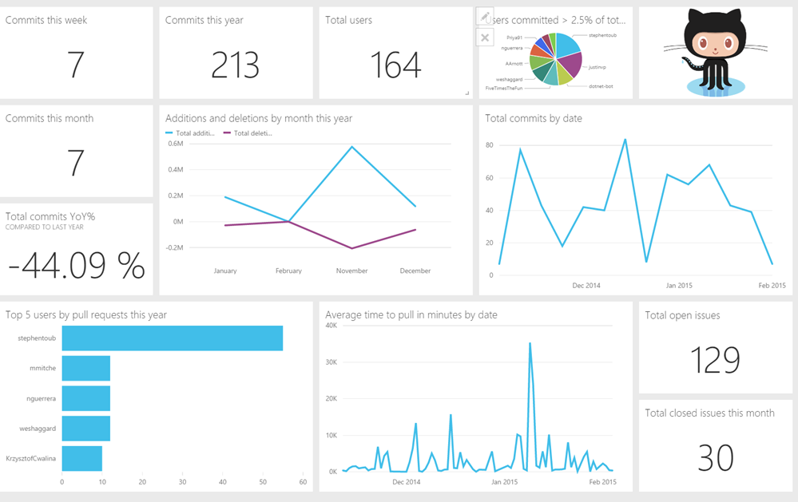
PowerBI
Notes:
Demo!

Slide 43

Notes:
The replicators are going haywire

Slide 44
Azure IoT services Reference Architecture
Devices and Data Sources
Data Transport
Device and Event Processing
Presentation
Azure Event Hubs & Service Bus
Data Visualization & Presentation
IP capable devices
Provisioning API
Device Management Portal
Device State Store (last known state)
Agent
Identity & Registry Stores
Legacy IOT devices
Stream Event Processor
Field
Gateway
Storage
Analytics/ Machine Learning
Low power devices
Agent

Slide 45

The Internet of Things – Manufacturing
GLOBAL OPERATIONS
MANUFACTURING PLANT
GLOBAL FACILITY INSIGHT
CUSTOMER SITE
Monitor production flow in near-real time to eliminate waste and unnecessary work in process inventory.
Manage equipment remotely, using temperature limits and other settings to conserve energy and reduce costs.
Transmits operational information to the partner (e.g. OEM) and to field service engineers for remote process automation and optimization.
I can see my production line status and recommend adjustments to better manage operational cost.
Management
I gain insight into usage patterns from multiple customers and track equipment deterioration, enabling me to reengineer products for better performance.
R&D
Provide cross-channel visibility into inventories to optimize supply and reduce shared costs in the value chain.
I know when to deploy the right resources for predictive maintenance to minimize equipment failures and reduce service cost.
Implement condition-based maintenance alerts to eliminate machine down-time and increase throughput.
Aggregate product data, customer sentiment, and other third-party syndicated data to identify and correct quality issues.
Field Service
THIRD-PARTY LOGISTICS
Notes:
Manufacturing Plant
Manage data remotely from a centralized location and push updates and key notifications to the factory floor, making relevant information available to manufacturing employees.
Monitor whether components are arriving at the plant floor as expected, and slow production if needed to reduce or eliminate excess work-in-process inventory
Predefine rules for equipment use and plant management (e.g. shut down production or equipment based on demand or environmental data), to optimize productivity and profitability
Establish predictive maintenance schedules - with planned maintenance, cost of operations can be reduced and throughput can be increased
Identify and correct quality issues – with IoT and the ability to perform Big Data analytics, manufacturers can increase the number of quality checks that are performed, collect more quality inspection data and analyze more data than ever before. This enables them to spot defect patterns, and correct them more quickly. This also enables manufacturers to create predictive algorithms so that times/places where quality issues may occur are identified ahead of time. (e.g. extra humid day might imply more likelihood of quality issues)
Customer Site and Third-Party Logistics
Continue to collect data from products once they leave the factory floor (e.g. throughout the distribution process and once implemented into customer sites) to help drive predictive maintenance and inform product improvements
E.g. a water pump could send data indicating that it will break down in 2-3 weeks. An analyst at the customer’s OEM or service provider could determine whether the pump is in need of simple repairs, or whether it makes sense to refurbish it. The analyst could also identify a spare parts promotion that the customer could take advantage of so the customer is prepared for future maintenance needs
Access more data than ever before and integrate with 3rd party syndicated data to improve process and quality control (e.g. use data on regional weather patterns to determine locations where weather conditions will result in higher demand, or view data about fuel and other input prices to predict profit margins)
Provide ‘single pane of glass’ visibility across all distribution/sales channels – this enables better inventory management and savings on logistics and distribution costs because the full channel would know would where products are, so redundancies can be reduced
Global Operations
powerful BI tools – derive business insights from Big Data analytics
Make data available to the right individuals for a variety of purposes based on role, such as product development, facility and device servicing, or business and operations management

Slide 46
Projects

Slide 47
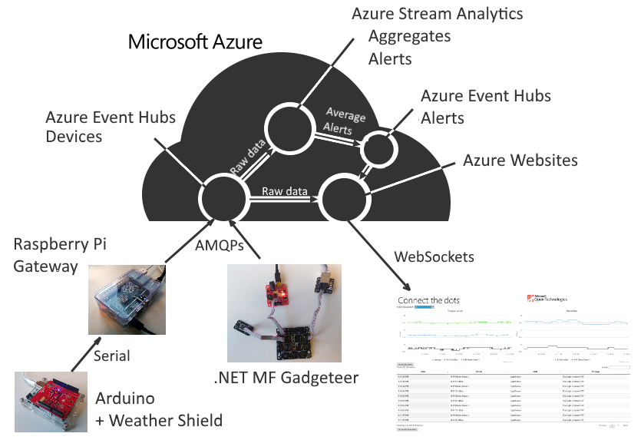
Notes:
ConnectTheDots.io
This is a great solution for hackathons

Slide 48
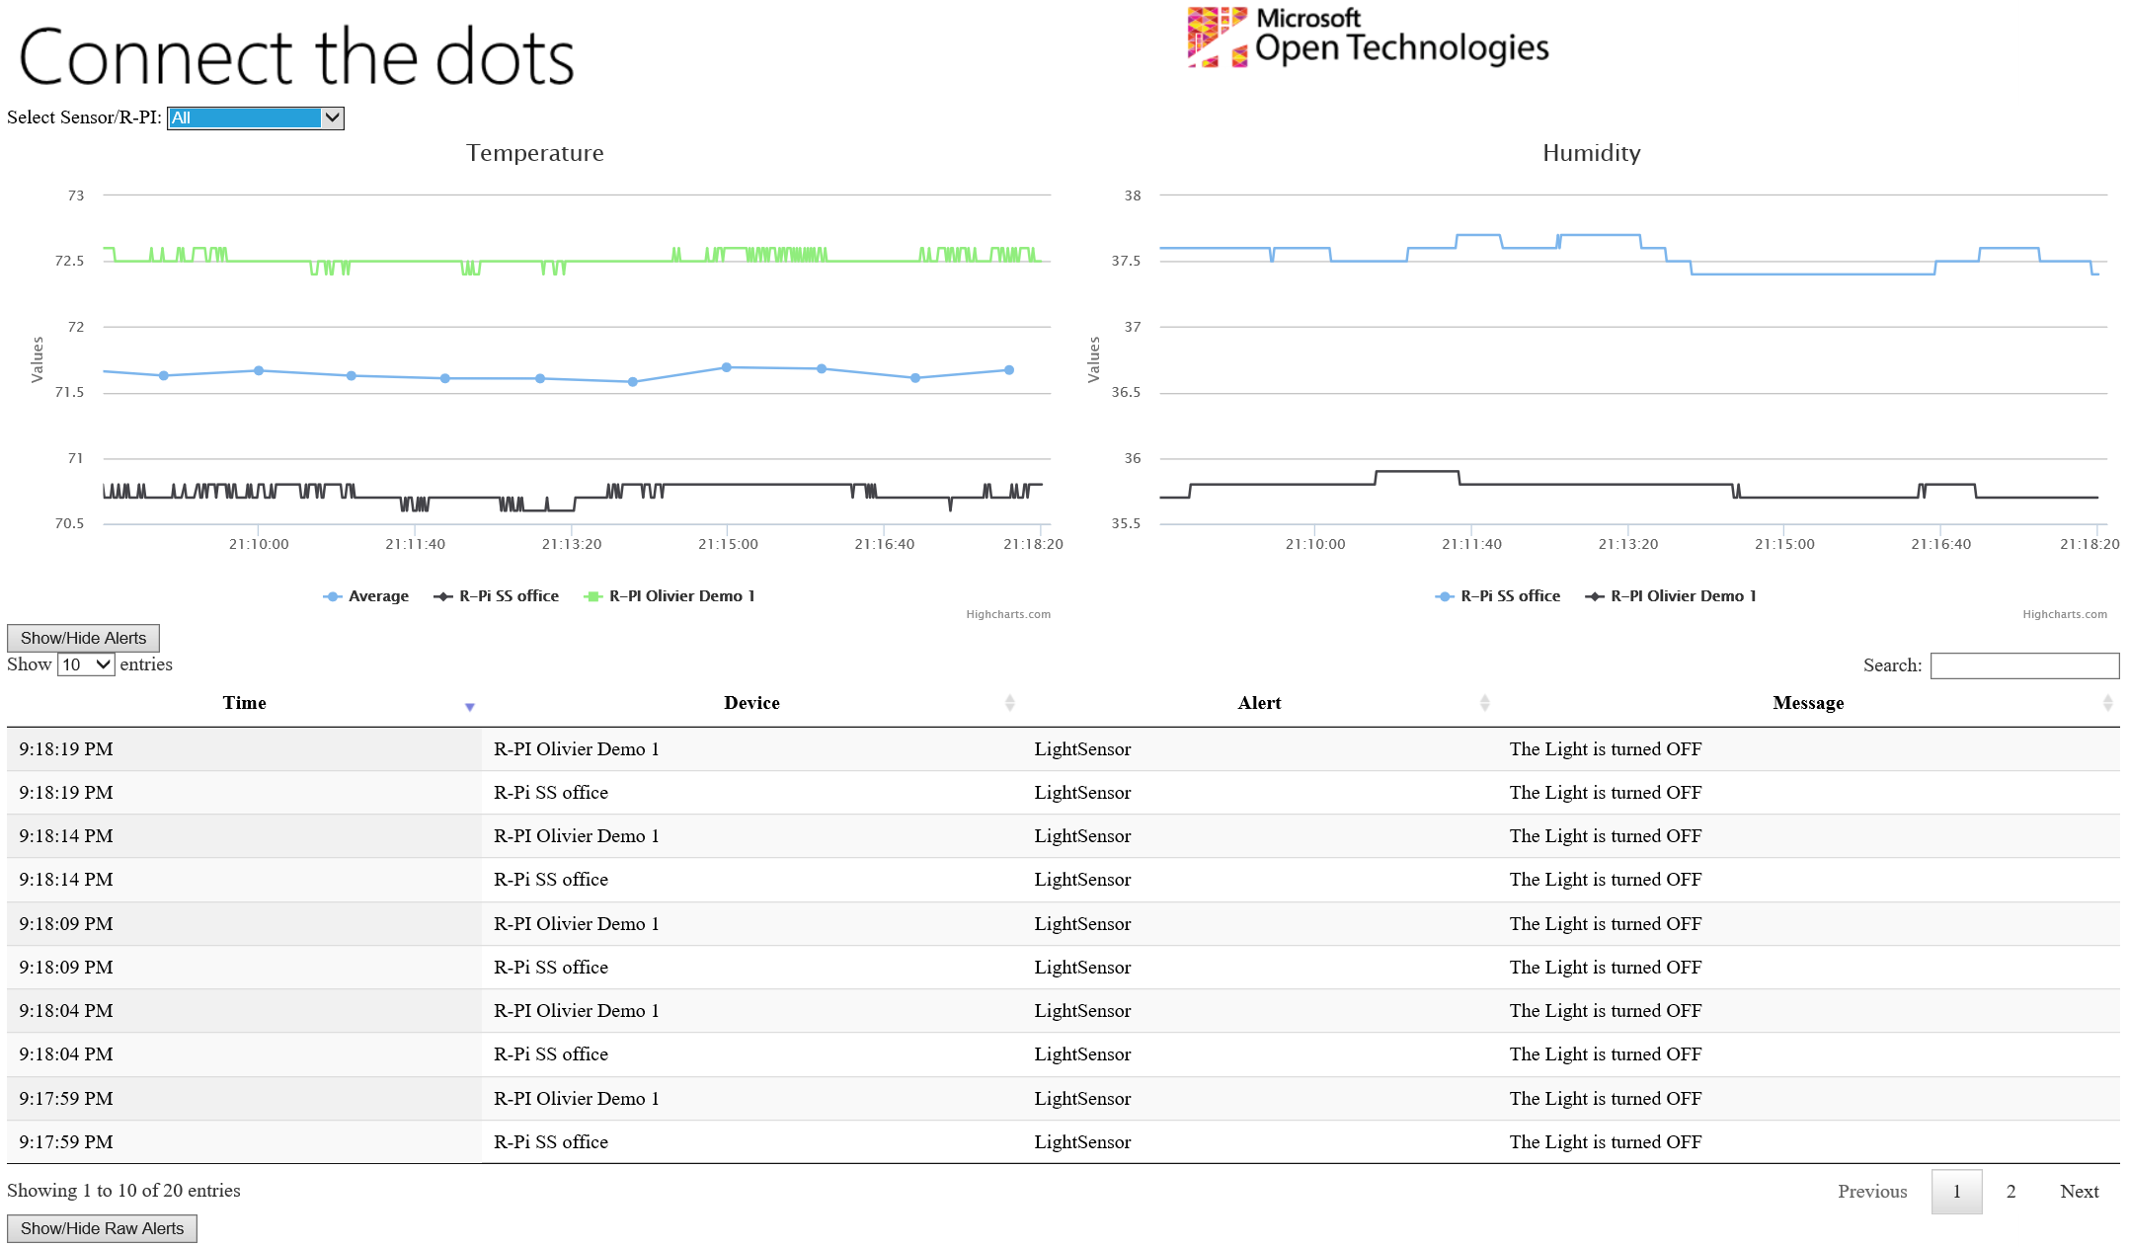

Slide 49
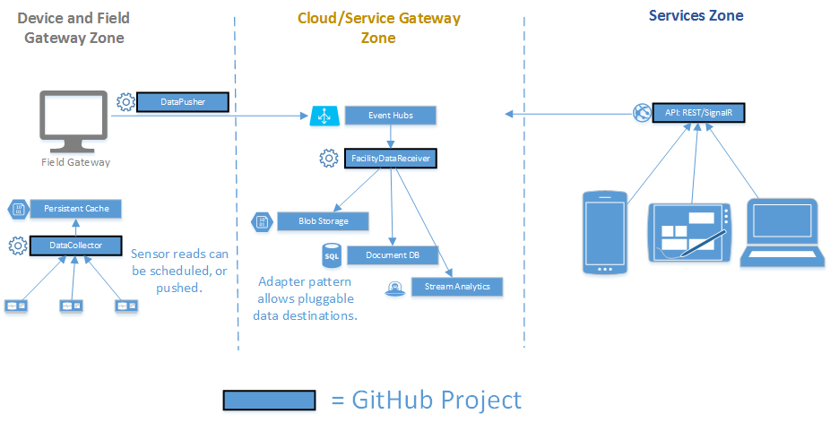
Manufacturing
Notes:
Manufacturing generates more data than any other industry. There is so much low hanging fruit.

Slide 50
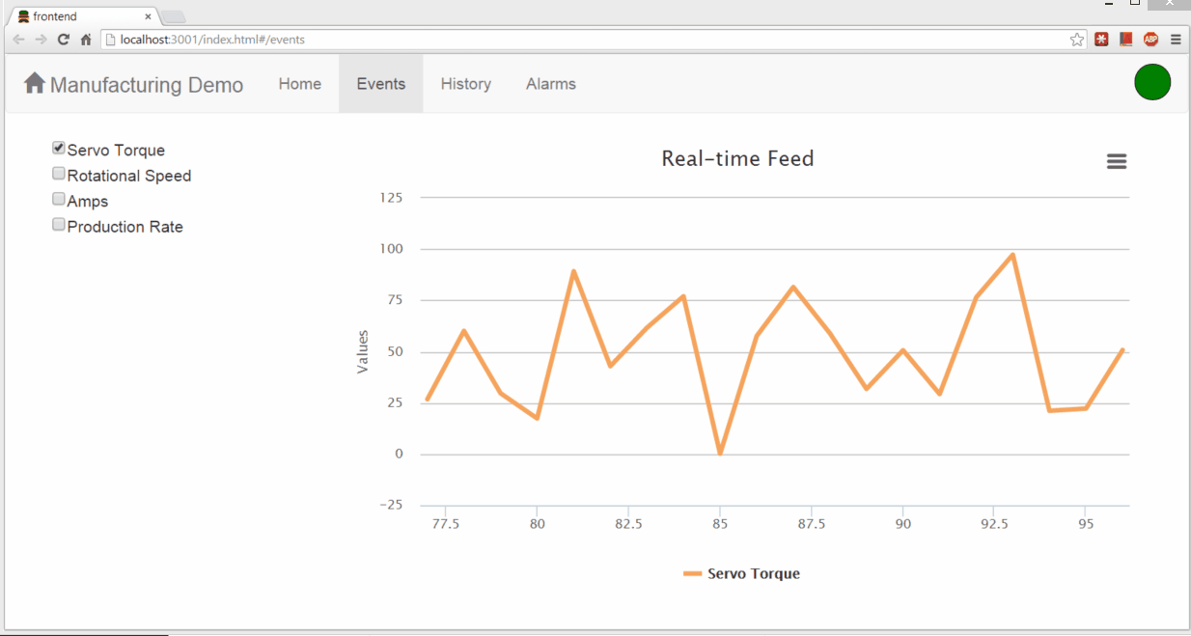

Slide 51
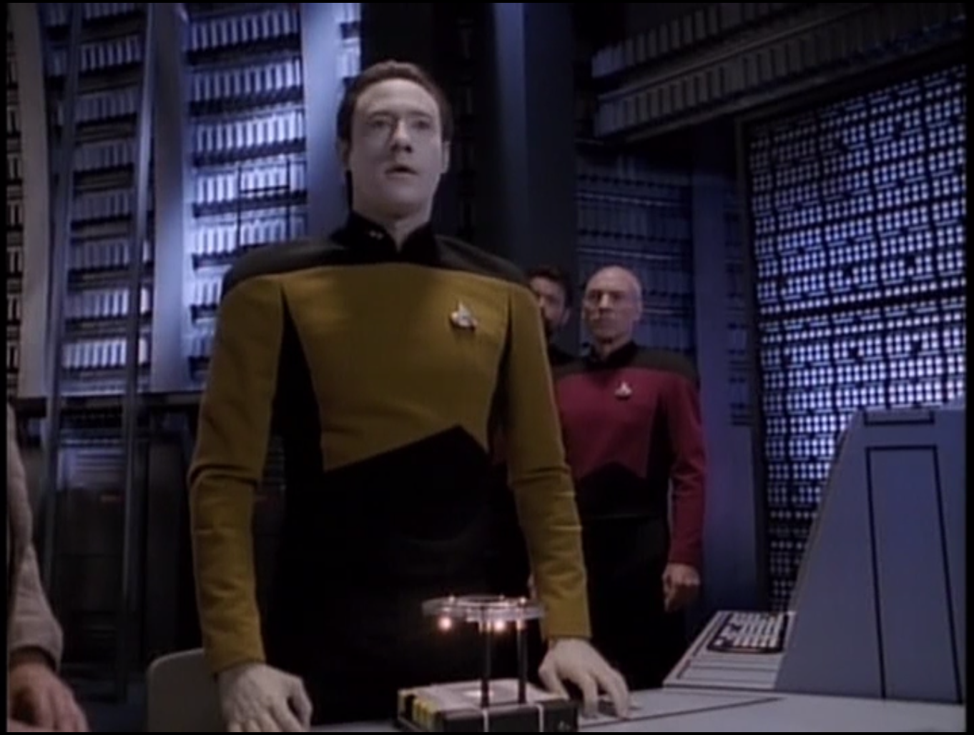
Notes:
The nanites needed a way to communicate, so they aggregated within data. A private cloud of sorts.
This is the future. Devices talking with each other directly, as well as communicating externally in an organized fashion.
Appliances talking together deciding when to run to save money
Fire alarms working together to save lives
Businesses coordinating production hours to avoid power brownouts
Manufacturing plant equipment coordinating order production
Traffic cameras warning drivers about delays via GPS and billboards
Doctors can view my historical medical stats while I’m on my way

Slide 52
Call to Action
Tell me about your scenario
Watch the //Build announcements
Follow @ytechie
Listen to the MS Dev Show (msdevshow.com)

Slide 53
“The most profound technologies are those that disappear.”
Mark Weiser, The Computer for the 21st Century

Slide 54
Questions / Thank you!

